Slide 1
Create new objects with Popups
November 14, 2014
Notes:
Guidewire training materials contain Guidewire proprietary information that is subject to confidentiality and non-disclosure agreements. You agree to use the information in this manual solely for the purpose of training to implement Guidewire software solutions. You also agree not to disclose the information in this manual to third parties or copy this manual without prior written consent from Guidewire. Guidewire training may be given only by Guidewire employees or certified Guidewire partners under the appropriate agreement with Guidewire.

Slide 2
Describe the differences in behavior between a view/edit popup and a view/edit/create popup
Configure a popup to create new objects
Configure a popup to dynamically render in read-only or edit mode

Slide 3
Create new popup behaviors
Configure a create new popup
Dynamically setting edit mode

Slide 4
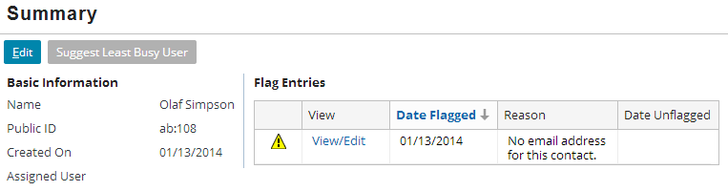
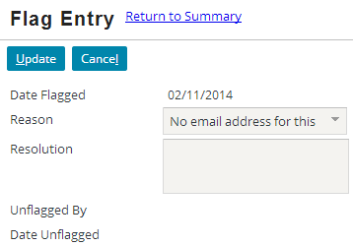
Popup type: view/edit
View/Edit popups only allow users to view and/or edit existing objects
Cannot create new objects
Notes:
A popup can be used to view and edit an object. You view and edit an object in a popup when the object is displayed somewhere (such as in a list view panel), but it is either not convenient to edit the object in that location, or some of the fields a user might wish to view or edit are not displayed in that location.

Slide 5
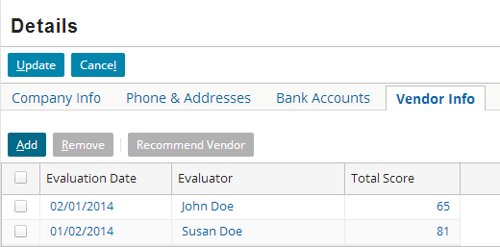
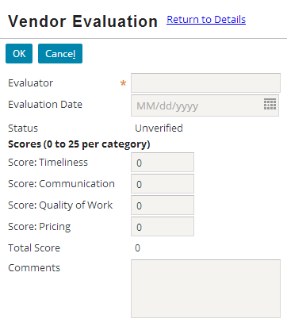
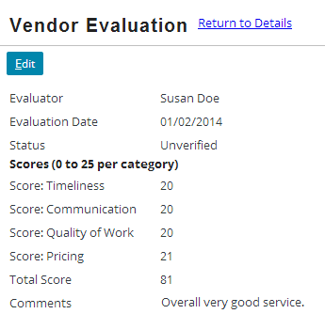
Popup type: view/edit/create
Creates New
View/ Edit
View/Edit/Create popups allow users to create objects
Add button to create
Navigation widget to view/edit
Notes:
In the slide example, the VendorEvaluationPopup popup allows user to view and edit existing vendor evaluation objects and to create new vendor evaluation objects.
There is a third type of popup that occurs occasionally in Guidewire applications - search popups. These popups are designed to let the user execute a search in a popup and then select one value in the search results, which is then returned to the widget that called the popup. It is possible to create a popup that allows users to create new objects but that could not be used to view and edit objects. In practice, there are not many business scenarios that would justify this type of behavior.

Slide 6
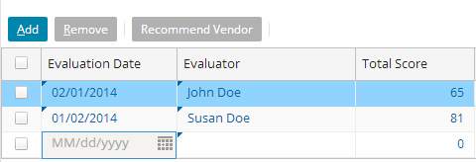
List view panel add button behavior
IteratorButtons widget renders the Add|Remove buttons
Iterator Buttons "linked" to list view panel
List view panel contains row iterator
RowIterator widget properties specify behavior of Add|Remove
Often, the configuration is to just add a new editable row
Notes:
The slide example depicts configurations that are not in TrainingApp. When clicking the Add button, the result should not to create a new row in the list view, but instead, create a new object in a popup in edit mode.
ABContactDetailsCV.ABCompany.pcf references VendorEvaluationsLV in a PanelRef widget. A toolbar in the panel ref contains the IteratorButtons widget. VendorEvaluationsLV exposes and "links" itself to the iterator buttons.
The IteratorButtons widget shows Add and Remove buttons. When referring to the Add button behavior, we are in fact discussing how the iterator buttons are configured to function. As you may recall from earlier lessons, the list view panel's RowIterator widget contains the properties that configure the behavior of the iterator buttons.

Slide 7
List view panel and Popup configurations
Modify the behavior of the Popup so that it…
Modify the behavior of the list view panel's Add button so that it…
Has a second entry point with no object in the signature
Creates a new object
Returns the new object to the list view
Does not create a new row in the list view panel
Navigates to the Popup
Does not pass an object to the popup
Notes:
When you configure a view/edit/create popup, you usually first create the popup as a view/edit popup and test the configuration. Then, you modify the popup to create new objects and test again.

Slide 8
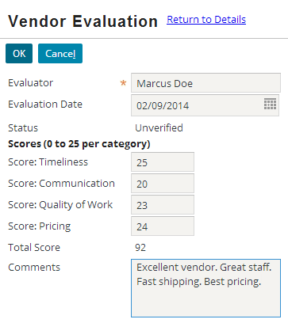
Popup configurations
No-object Entry Point 2
New object
Has a second, no-object entry point
Creates a new object
Returns the new object to the list view
Notes:
A view/edit only popup has only a single entry point. Entry point 1 is a navigation cell widget that passes an object to a view/edit popup (not shown in the slide example, but any of the navigation cell widgets will use it).
A view/edit/create popup has two entry points. Entry point 2 (shown in the slide example) specifies a signature that does not pass an object. A signature without an object parameter is called a no-object entry point. For no-object entry points, you can configure the destination location, in this case the popup, to create the new object.
When a popup creates a new object, the source container (often a list view panel) does not know about the object. The popup must return the object to the source container and the source must commit the object to the appropriate array that is associated with the parent object. If the popup does not return the newly created object to the source container, the object might get committed to the database (depending on the presence of referential integrity constraints), but the object would not get associated with the parent object array. The result is an orphaned object. From a UI perspective, the object would not appear in the list view panel.

Slide 9
Add button behavior configurations
No Object
Does not create a new row in the list view panel
Navigates to the Popup
Does not pass an object to the popup
Notes:
An editable list view can let you create new objects in one of two places. Some editable list view panels let you create new objects in-line (in a new row in the list view itself). Other editable list view panels let you create new objects in a separate popup.
Editable list view panels let you create new objects in-line. Clicking the "Add" button does not cause the application to navigate to a new location. Instead, the application remains in the current location, and a new row simply appears at the bottom of the list view.
When a list view panel is configured to create new objects in a separate popup, then the list view panel must navigate to the popup when the new object is to be created.

Slide 10
Create new popup behaviors
Configure a create new popup
Dynamically setting edit mode

Slide 11
Steps to configure a view/edit/create popup
Create a second, no-object entry point
Configure the popup to create a new object
Configure the popup to return the new object
Configure edit buttons pick value
Configure the row iterator pick location
Deploy PCFs
Notes:
The configuration steps assume that you have already created and tested a view/edit popup.

Slide 12
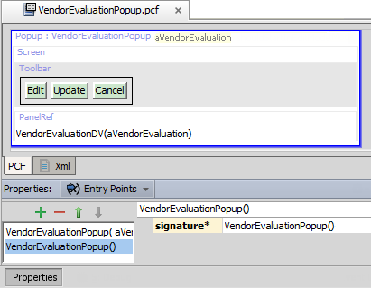
Create a second, no-object entry point
Step 1
Select Popup location
Properties → Entry Points
Create a second entry point
Signature
Do not specify parameter
An entry point is a reference used by widgets to navigate to a given location
Notes:
Locations can have multiple entry points. This is often done for locations where different widgets might navigate to it under different circumstances. For example, when a popup is used to both edit an existing object and create a new one, it must have multiple entry points, one for each circumstance.
Having multiple entry points is similar to the concept of overloading a method in object-oriented programming. When a location has multiple entry points, each entry point must have a unique list of expected objects and their data types. For example, a popup could theoretically have:
One entry point with no objects
One entry point with a single VendorEvaluation object
One entry point with a single boolean value
One entry point with a VendorEvaluation object and a boolean value
Whenever a widget navigates to this popup, it would need to specify either no objects, or one object of type VendorEvaluation, or one object of type boolean, or two objects - one of type VendorEvaluation and one of type boolean. The Guidewire application can automatically determine the correct entry point to use.

Slide 13
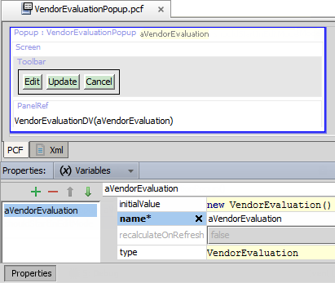
Configure popup to create a new object
Step 2
Select Popup location
Properties → Variables
initialValue
Specify an expression to create a new object
Set the initialValue to new objectType()
Notes:
Every location variable has an initialValue property. The initial property is not used when the location receives an object by that name from the navigation widget that called it. Rather, the property is used only when the navigation widget does not pass in an object of that type. In this situation, the object must be created by the popup location itself.
The initialValue of new objectType() is object-oriented syntax for instantiating a new object. Whenever the navigation widget uses an no-object entry point, the popup creates a new object of the type specified by the constructor in the intialValue property.

Slide 14
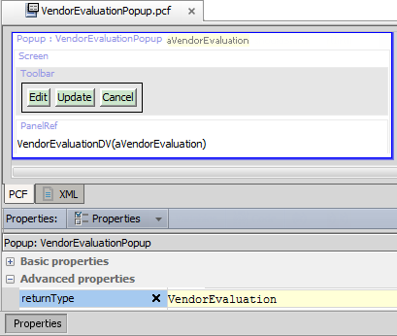
Configure popup to return the new object
Step 3
Select Popup location
Properties → Properties
returnType
Set to the variable object type
Every view/edit popup must have a return object type
Notes:
A view/edit/create popup is analogous to a method that returns a value (function). It has a return value that is of a specific type. The pickValue property defines the object variable returned by the popup location to the source container. The returnType property defines the type for the variable being returned. In the slide example, the popup returns the aVendorEvaluation object variable of the type VendorEvaluation.

Slide 15
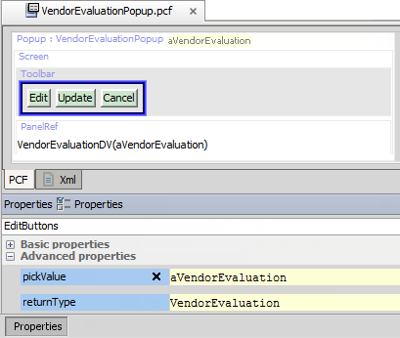

Configure edit buttons pick value
Step 4
Select EditButtons
Properties → Properties
pickValue
Set property to variable object name
Every view/edit popup must have a toolbar with an EditButtons widget
Notes:
The pickValue property defines the object variable returned by the popup location to the source container.
The pickValue behavior is similar to creating a method that returns a value (function) for an object-oriented class. If the method has a return value, then you must specify the return value's type. For example, consider the following Gosu function.
function convertPoundsToKilograms ( poundValue : float ) : float {
var kilogramValue = poundValue / 2.2
return kilogramValue
}
The final line of the convertPoundsToKilograms method identifies that the value to return is the value of kilogramValue that is of the type float.
The property that names the object returned from the popup is called "pickValue" for historical reasons. Originally, popups were designed to be used for popup searches. This was needed when a widget referenced an object that one typically needed to look up. For example, an AccountDetailView might have an IndustryCode field. If there are hundreds of industry codes, the user typically needs to look up the code that is needed. To do this, they would click a button next to the widget. This would launch a search window in a popup. The user could entry criteria (such as the name associated with the industry code) and click Search. A list of matching industry codes would appear, and the user could pick one of them. The code would then be returned to the IndustryCode widget and hence the invention of the term, pickValue. Later, the capabilities of popups were expanded to include the ability to create new objects. But for backwards compatibility, the name pickValue had to be kept as is.

Slide 16
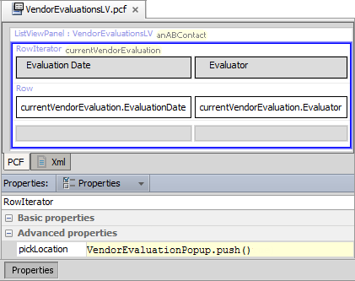
Configure the row iterator pick location
Step 5
Select list view panel RowIterator
Properties → Properties
pickLocation
Use non-object entry point
Set to popupName. push()
Configure the row iterator to modify the IteratorButtons widget behavior for the Add button to navigate to the popup

Slide 17
Deploy PCFs
Step 6
Restart Server
Reload PCFs
PCFs read at server startup
ALT+SHIFT+L
Internal debug tools enabled
Internal Tools
Reload → Reload PCF Files
Page Configuration File
Popup PCF
Page Configuration File
Popup PCF
Notes:
It is also possible to reload PCF files using the Guidewire API and/or internal server tools. The Reload PCF command can be found on the Reload page in Internal Tools. To access Internal Tools, the EnableInternalDebugTools setting in the config.xml file must be set to true. The keystroke to open the Internal Tools page is ALT+SHIFT+T. In the tab bar, select Internal Tools --> Reload. On the Reload page, click the Reload PCF Files button. Both the keystroke ALT+SHIFT+L and the Reload PCF Files button call the same static method: gw.api.tools.InternalToolsUtil.reloadPCFs().

Slide 18
New object configuration summary
Behavior | Where To Set Property | Property | Value
Allow for navigation to popup without passing any objects to it | Popup's Entry Points tab | Entry point signature | popupName(<empty list>)
In popup, create a new object if the navigation widget did not pass an object | Popup's Variables tab | initialValue | new objType()
Once new object is saved, pass the new object back to the source list view panel | Popup's detail view toolbar's Edit Buttons | pickValue | objName
 | Popup | returnType | objType
On parent list view, when Add is clicked, navigate to the popup | Row Iterator in source list view panel | pickLocation | popupName.push()

Slide 19
Create new popup behaviors
Configure a create new popup
Dynamically setting edit mode

Slide 20
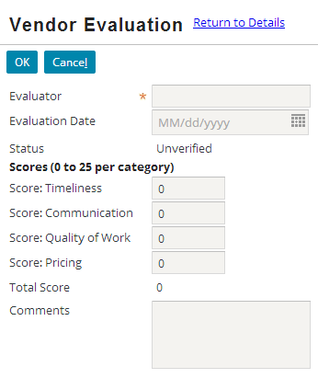
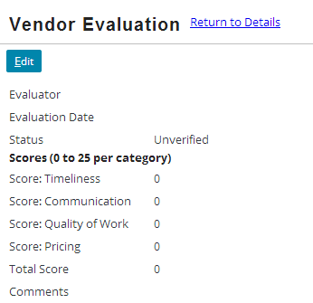
startInEditMode: create
startInEditMode = true
startInEditMode is a Popup location property
Users often want to create new objects starting in edit mode
startInEditMode = false
Notes:
In the slide example, the user clicks the Add button and the Guidewire application navigates to the VendorEvaluationPopup location.
For a popup location, you can set the startInEditMode property to true. The startInEditMode property takes a boolean value. When a user navigates to the popup, the popup is in edit mode. All editable fields can be edited and the EditButtons widget is in edit mode (Update | Cancel).
When the startInEditMode property is set to false, the popup location is initially rendered in read-only mode. All editable fields are read-only and the EditButtons widget is in read-only mode (Edit). If a user wants to edit the object, the user needs to click Edit.
To improve the user experience, you will most likely want to eliminate the need for the user to click Edit. You can do this by setting the startInEditMode property to true.

Slide 21
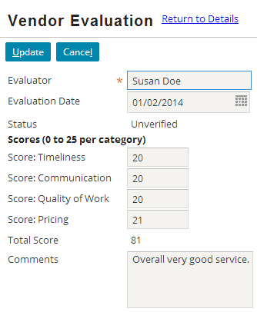
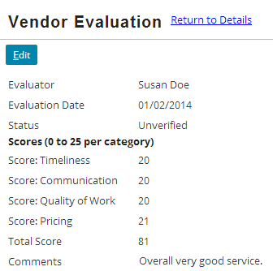
startInEditMode: view/edit
startInEditMode = true
List view panel in edit mode…start popup in edit mode
List view panel in read-only mode…start popup in read-only mode
startInEditMode = false
Notes:
In the slide example, the user clicks a navigation cell widget in the list view panel. The list view panel is in edit mode, but could be in read-only mode. The Guidewire application navigates to the VendorEvaluationPopup location.
For a popup location, you can set the startInEditMode property to true. The startInEditMode property takes a boolean value. When a user navigates to the popup, the popup is in edit mode. All editable fields can be edited and the EditButtons widget is in edit mode (Update | Cancel).
When the startInEditMode property is set to false, the popup location is initially rendered in read-only mode. All editable fields are read-only and the EditButtons widget is in read-only mode (Edit). If a user wants to edit the object, the user needs to click Edit.
When the list view panel is in read-only mode, it may make more sense for the popup to start in read-only mode. When the list view panel is in edit mode, it may be a more efficient user experience for the popup to start in edit mode. To address both uses cases, it is possible to dynamically set the value of the startInEditMode property by passing an additional parameter to the entry point.

Slide 22
Why have the popup in edit mode?
Desired action | Is the parent list view in edit mode? | Should the popup be in edit mode?
View or edit an existing object | Popup's Entry Points tab | No. The list view panel is in read-only mode, so popup should initially match the read-only mode.
View or edit an existing object | Popup's Variables tab | Yes. The list view panel is in edit mode, so popup should initially match the edit mode.
Create a new object | n/a | Yes. The user wants to specify values for a new object, which requires that the object to be in edit mode.

Slide 23
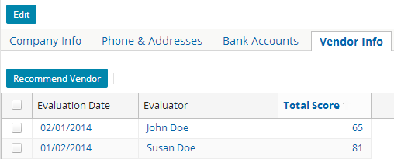
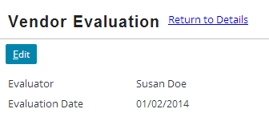
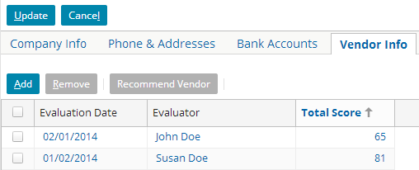
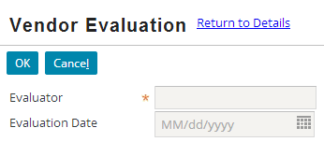
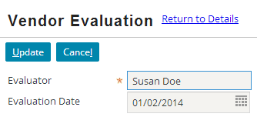
Determining edit mode dynamically
List View Panel read-only
View/Edit popup read-only
Boolean = false
List View Panel edit
Boolean = true
Create popup edit
Boolean = true
View/Edit popup edit
Pass a Boolean value to popup to dynamically set value of startInEditMode property
Notes:
You can configure a popup to start in edit mode dynamically by passing an additional boolean value. The startInEditMode is a dynamic property that can evaluate an expression that returns a boolean value.
When navigating from a list view panel in read-only mode, pass false. When rendering the popup, if the value passed was false, start in read-only mode.
When navigating from the Add button, pass true. When rendering the popup, if the value passed was true, start in edit mode.
When navigating from a list view panel in edit mode, pass true. When rendering the popup, if the value passed was true, start in edit mode.

Slide 24
Steps to configure dynamic edit mode
Create a popup boolean variable
Configure the popup startInEditMode property
Modify the entry point signature for the boolean variable
Modify the row iterator pick location to pass a true boolean
Modify the navigation widget action to pass boolean
Deploy PCFs

Slide 25
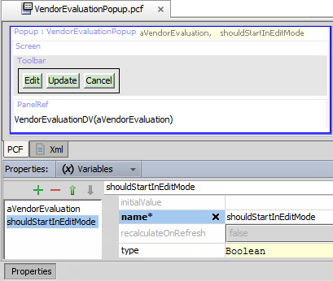
Create a popup boolean variable
Step 1
Select Popup location
Properties → Variables
Create a variable
Specify name
Specify type as Boolean
Initial value to be set by navigation widget
Navigation widget will pass variable to popup and popup will use variable to determine if it starts in edit mode
Notes:
The startInEditMode property takes a Boolean value.

Slide 26
Configure popup startInEditMode property
Step 2
Select Popup location
Properties → Properties
Specify the startInEditMode property
Set to shouldStartInEditMode
startInEditMode = true puts the location into edit mode when the user enters it
Notes:
A view/edit/create popup is analogous to a method that returns a value (function). It has a return value that is of a specific type. The pickValue property defines the object variable returned by the popup location to the source container. The returnType property defines the type for the variable being returned. In the slide example, the popup returns the aVendorEvaluation object variable of the type VendorEvaluation.

Slide 27


Modify entry point signature for boolean
Step 3
Select Popup location
Properties → Entry Points
Modify signature for each entry point
Add additional parameter
Use name of and type of variable
Object to view/edit; Boolean to indicate mode
No-object creates new object; just Boolean to indicate edit mode

Slide 28
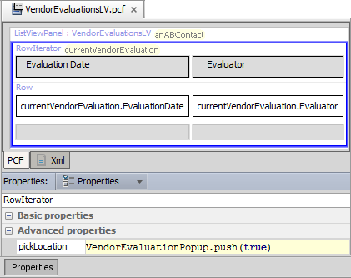
Modify row iterator pick location
Step 4
Select list view panel RowIterator
Properties → Properties
pickLocation
Use non-object entry point
Set to popupName. push(true)
Modify row iterator pickLoaction property
Affects IteratorButtons widget (Add|Remove) behavior
Add button to navigate to an edit mode popup for new object
Notes:
When a user clicks Add to create a new object in the popup, the resulting popup is always rendered in edit mode.

Slide 29
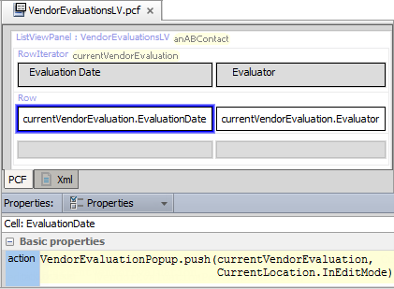
Modify the navigation widget action
Step 5
Select navigation widget
Properties → Properties
action
Specify entry point with row iterator object and Boolean arguements
CurrentLocation. InEditMode
true if location in edit mode
false if location in read-only
VendorEvaluationPopup.pcf
Notes:
Every location has an InEditMode property that returns true if the location is in edit mode and false if it is in read-only mode. The expression CurrentLocation.InEditMode returns true if the location is in edit mode and false if it is in read-only mode. From a widget or location, you can access information about the current location by referencing the CurrentLocation object. This object represents the location the user is currently at. From here, you can access information about that location, such as whether it is in edit mode or not.

Slide 30
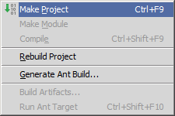
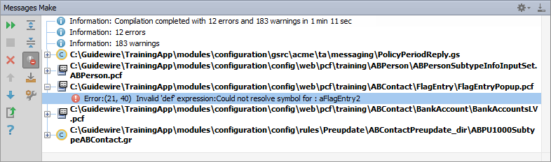
Make project to see all PCF errors
Build → Make Project
Compiles only modified files since the last compilation
Opens Messages (Make) window for build summary
Filter for errors
Great way to see all PCF errors
Notes:
Make Project: All the source files in the entire project that have been modified since the last compilation are compiled. Dependent source files, if appropriate, are also compiled. Additionally, the tasks tied to the compilation or make process on modified sources are performed.

Slide 31
Deploy PCFs
Step 6
Restart Server
Reload PCFs
PCFs read at server startup
ALT+SHIFT+L
Internal debug tools enabled
Internal Tools
Reload → Reload PCF Files
Page Configuration File
Popup PCF
Page Configuration File
Popup PCF
Notes:
It is also possible to reload PCF files using the Guidewire API and/or internal server tools. The Reload PCF command can be found on the Reload page in Internal Tools. To access Internal Tools, the EnableInternalDebugTools setting in the config.xml file must be set to true. The keystroke to open the Internal Tools page is ALT+SHIFT+T. In the tab bar, select Internal Tools --> Reload. On the Reload page, click the Reload PCF Files button. Both the keystroke ALT+SHIFT+L and the Reload PCF Files button call the same static method: gw.api.tools.InternalToolsUtil.reloadPCFs().

Slide 32
Describe the differences in behavior between a view/edit popup and a view/edit/create popup
Configure a popup to create new objects
Configure a popup to dynamically render in read-only or edit mode

Slide 33
When does a popup need to have two entry points?
You click an Add iterator button for a list view. Where does the new object get created when...
...the row iterator's pickLocation property value is VendorPopup.push()?
...the row iterator's pickLocation property has no value?
Assume a location has a aVendorEval variable with an initialValue of new VendorEvaluation().
When is the initial value used?
When is the initial value ignored?
Why must a popup that creates a new object pass that object back to the source list view panel?
(continued)
Notes:
Answers
1) A popup needs two entry points when the popup is used for both viewing and editing existing objects and creating new objects. One entry point is used to view or edit an existing object. The other is used to create a new one.
2a) The new object gets created in the specified popup (in this case, VendorPopup).
2b) The new object gets created in a new row at the bottom of the list view. In this case, no navigation occurs.
3) The initial value of the object is used if the navigation widget did not pass the object to the location. The initial value is ignored if the navigation widget did pass the object to the location.
4) A popup must pass a newly created object back to the list view so that the list view can add the new object to the appropriate array.
(continued)

Slide 34
For each "create new" popup behavior, specify the value to set the given property to.
a) new objType() b) objName c) objType
d) popupName(<empty list>) e) popupName.push()
Behavior | Where To Set Property | Property | Value
Allow for navigation to popup without passing any objects to it | Popup's Entry Points tab | Entry point signature | (5)
In popup, create a new object if the navigation widget did not pass an object | Popup's Variables tab | initialValue | (6)
Once new object is saved, pass the new object back to the source list view panel | Popup's detail view toolbar's Edit Buttons | pickValue | (7)
 | Popup | returnType | (8)
On parent list view, when Add is clicked, navigate to the popup | Row Iterator in source list view panel | pickLocation | (9)
Notes:
Answers
5) answer is D. A location entry point must start with the name of the location. If it accepts no objects, then it ends with a set of parentheses with no objects, "()".
6) answer is A. When an object isn't passed to a popup, the initial value of the object variable is "new objType()", such as "new VendorEvaluation()" for a popup that creates vendor evaluations.
7) answer is B. The "pickValue" is the value - or the name of the object - to be returned to the list view.
8) answer is C. The "returnType" is the type of the object to be returned to the list view.
9) answer is E. This is the only answer that can be used by a navigation widget to navigate to a location. In other words, it's the only one that ends in a .go() or .push().

